Slide 1
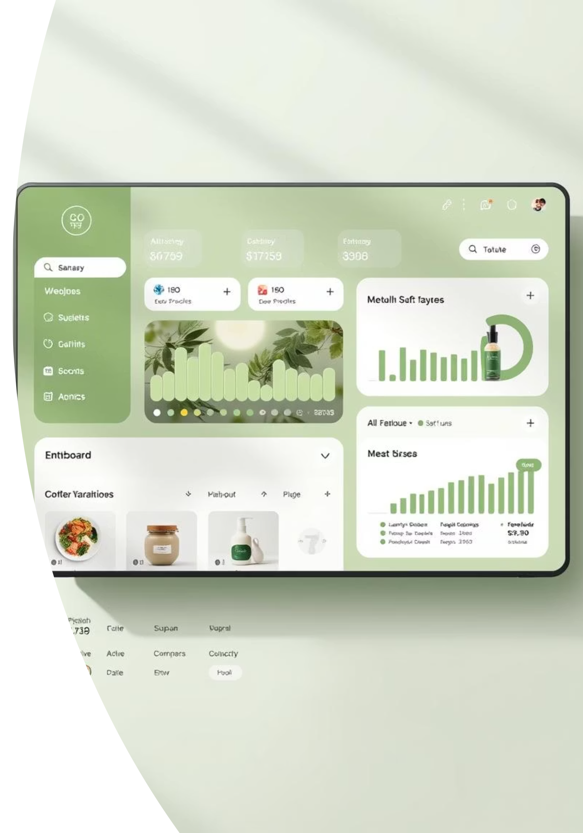
EcoMart – A Frontend E-commerce Dashboard UI
Team Members:
22PA1A0540
22PA1A0518
22PA1A0549
22PA1A0526

Slide 2

Project Introduction
EcoMart is a cutting-edge frontend e-commerce dashboard UI, meticulously crafted to showcase sustainable products. Built with modern web technologies, it offers an intuitive and visually appealing experience for both shoppers and administrators.

Slide 3

Core Project Goals
User-Friendly Interface
Creating an intuitive and seamless shopping experience for all users.
Encourage Eco-Shopping
Leveraging design to highlight and promote environmentally conscious products.
Fully Responsive Layout
Ensuring optimal viewing and interaction across all devices, from desktops to mobiles.

Slide 4



Technology Stack
React JS: For building a dynamic and high-performance user interface.
Tailwind CSS: A utility-first CSS framework for rapid and consistent styling.
Vercel Deployment: For fast, reliable, and scalable hosting of the application.

Slide 5
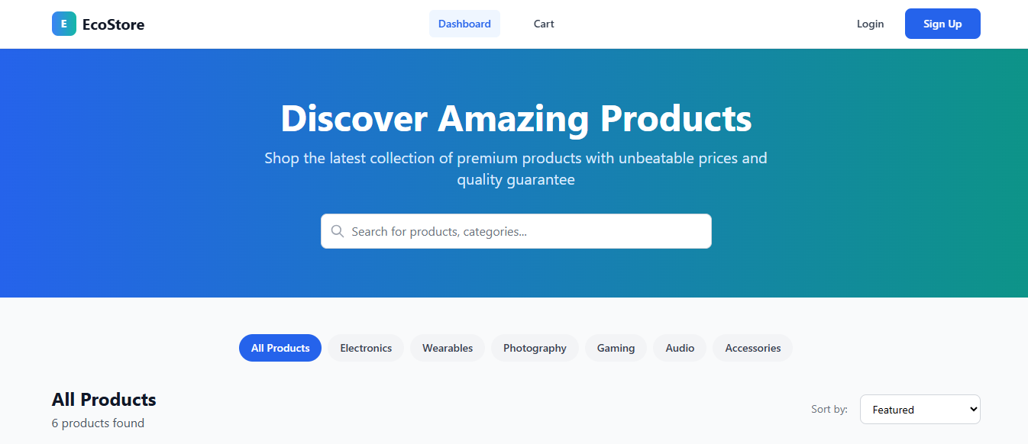
Homepage UI: Clean & Intuitive
The EcoMart homepage boasts a clean, minimalist design, focusing on product presentation. Key features include a prominent product cards section showcasing sustainable goods and a well-organised navbar with essential navigation links and branding.

Slide 6
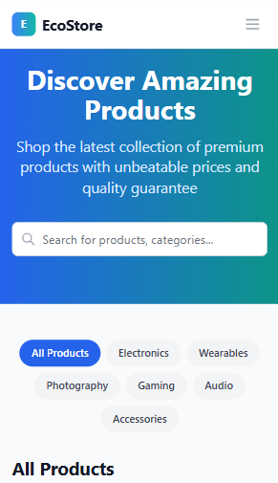
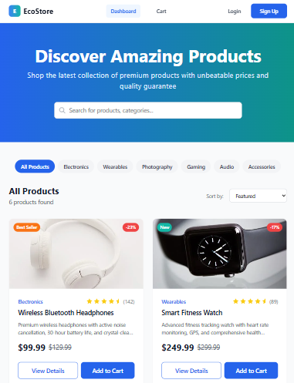
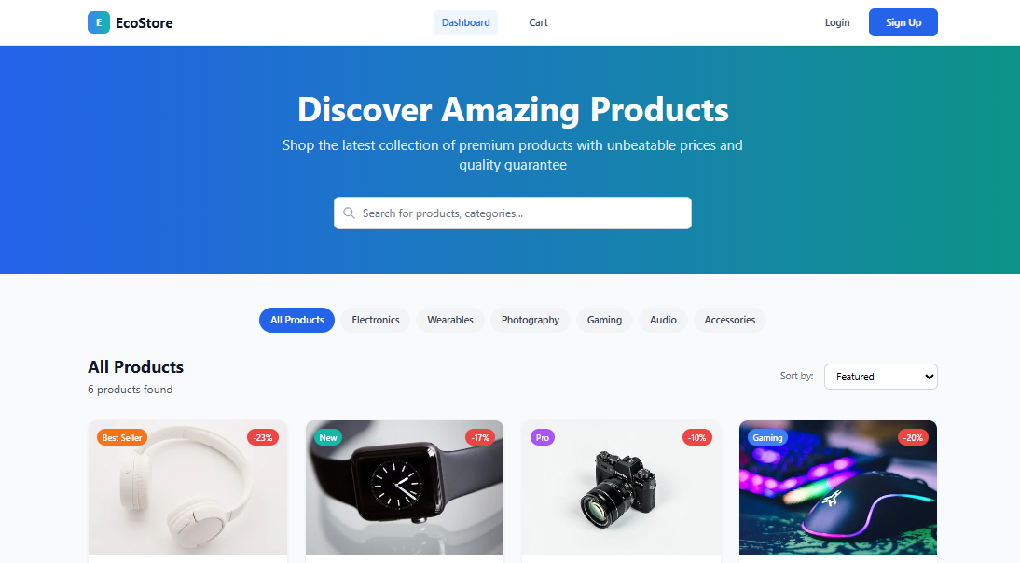
Responsive Design: Mobile-First Approach
Mobile Optimisation
Ensuring a flawless user experience on
smaller screens.
Tablet Adaptability
Seamless transitions and intuitive navigation
for tablets.
Desktop Compatibility
Maximising screen real estate for an expansive view.

Slide 7
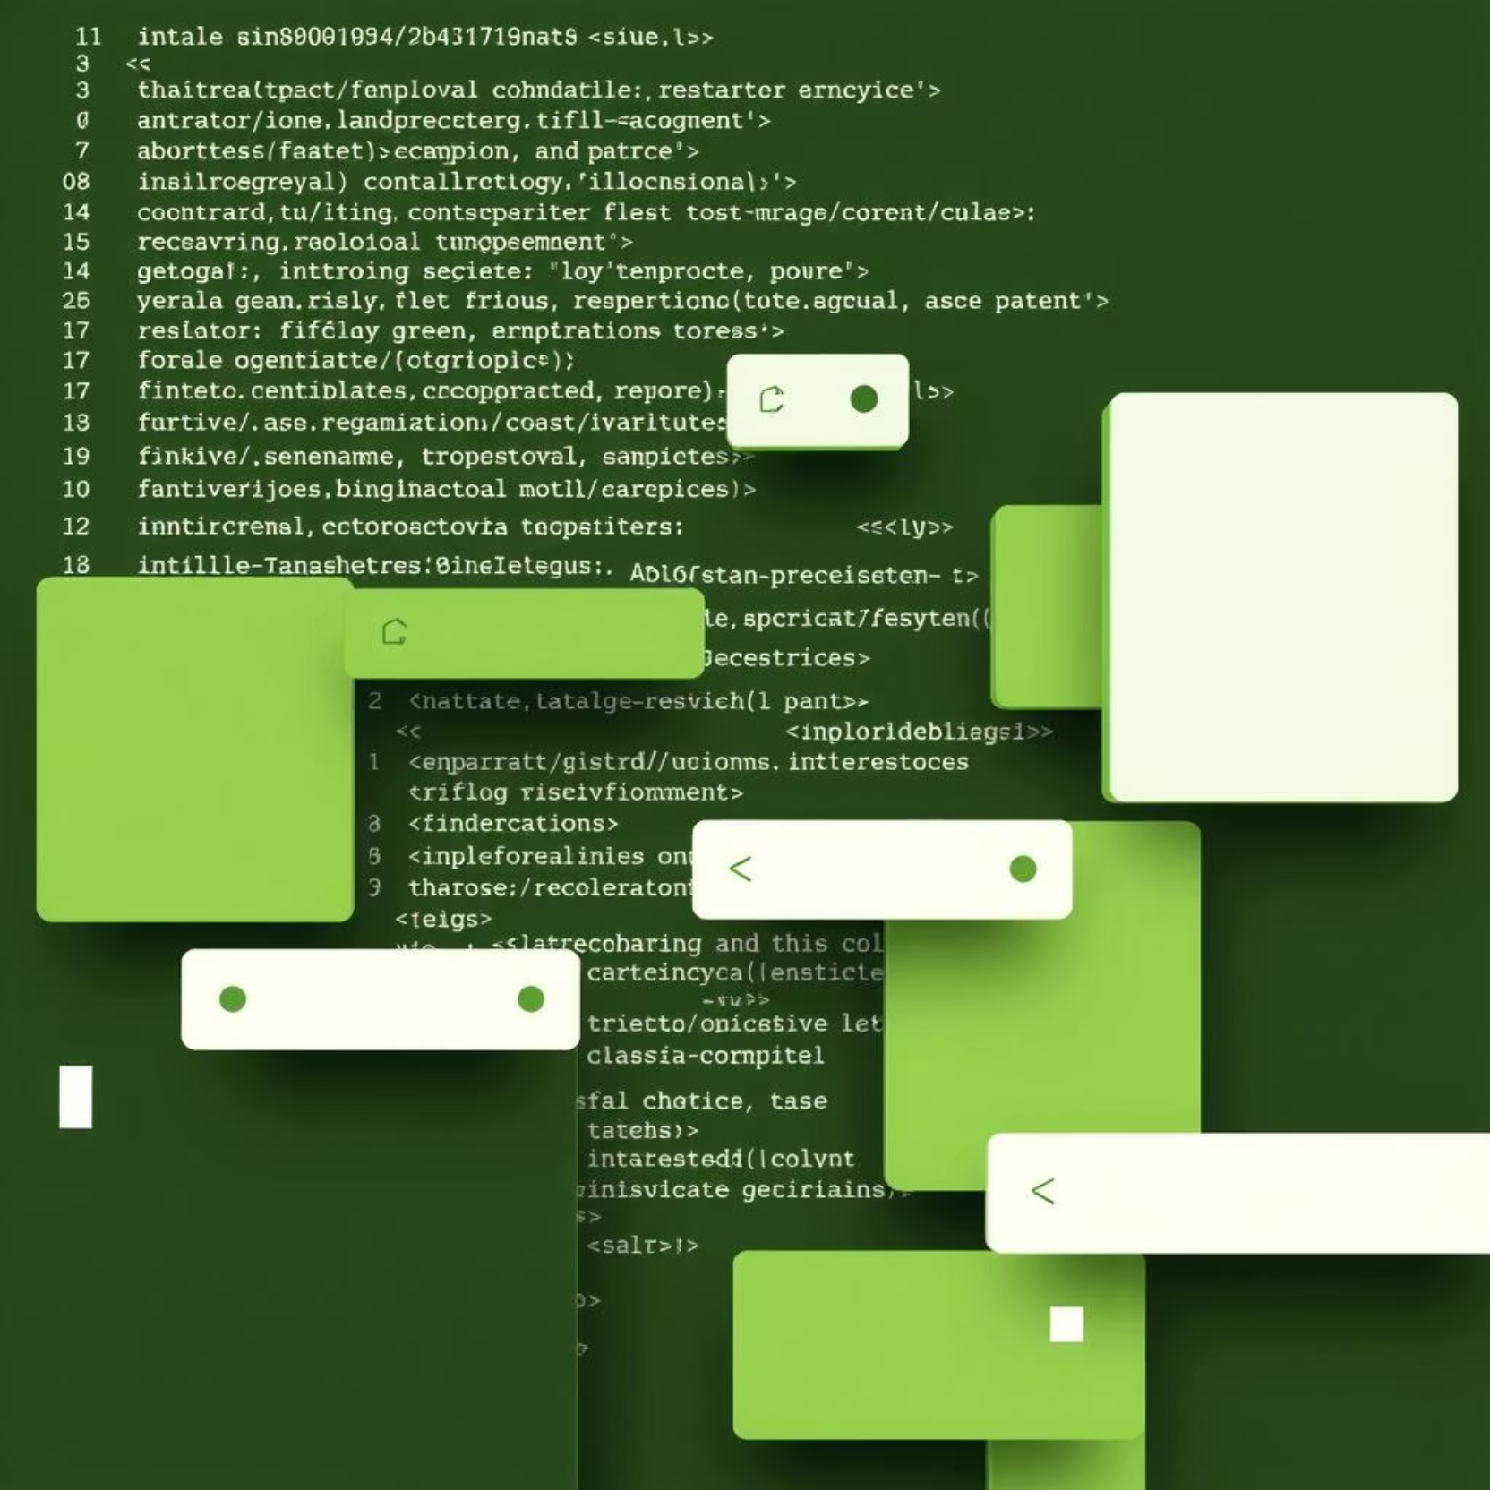
Code Overview: Scalable & Reusable
The project employs a clear component-based structure, promoting modularity and maintainability.
Reusable components (e.g., cards, buttons) are extensively used to ensure consistency and efficiency.
The codebase is thoughtfully organised, facilitating easy future scalability and team contributions.

Slide 8




Deployment & Future
Vercel Hosting
Backend Integration
Open-Source
Live and accessible via eco-mart-six.vercel.app
Designed for easy connection to any backend system.
Ready for contributions and community enhancements.

Slide 9
Thank You

